Slide 1

Space X Falcon 9 Landing Analysis
Sayali Deshpande
March 20,2024

Slide 2
Outline
Executive Summary
Introduction
Methodology
Results
Conclusion
Appendix

Slide 3
Executive Summary
Methodologies Summary:
Data Collection
Data Wrangling
Exploratory Data Analysis with Data Visualisation
Exploratory Data Analysis with SQL
Interactive Visual Analysis
Predictive Analysis (Classification)
Results Summary:
- Exploratory Data Analysis Results
- Geospatial Analysis
- Interactive Dashboard
- Predictive Analysis with Classification model

Slide 4
Introduction
Falcon 9 rocket launch costs for upward of 165 million dollars offered by some providers in the market whereas Space X advertised launch of Falcon 9 at 62 million dollar price. This is considerably cheaper solution. The shift in price is because Space X can reuse the first stage.
We have to draw predictions on successful landing of first stage to determine the cost of one launch. It will also help in case any other company would want to bid against Space X for the rocket launch.
This exercise will predict Space X's Falcon 9 first stage successful landing.

Slide 5
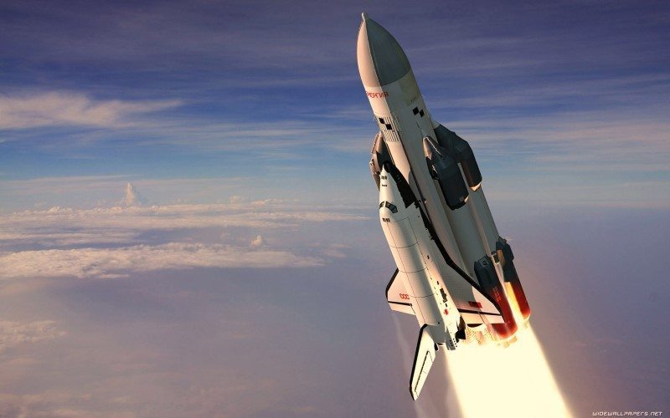
METHODOLOGY

Slide 6
Methodology Summary:
Data Collection:
Using SpaceX REST API
Web scraping
Data Wrangling:
.fillna(): To remove Null/Undefined values
.value_counts(): To determine the following
Number of launches on each site
Number and occurrence of each orbit
Number and occurrence of mission outcome per orbit type
Adding a landing outcome label
Exploratory Data Analysis:
Using SQL for data manipulation on SpaceX dataset
Visual representation to identify pattern and relationship between variables using Pandas and Matplotlib

Slide 7
Contd. Methodology Summary..
Interactive Visual Analytics:
Geospatial analytics using Folium
Interactive dashboard with Plotly Dash
Data Modelling and Evaluation:
Determine training labels, Hyperparameter for SVM, Classification Trees and Logistic Regression
Plot confusion matrix for each classification model
Assess accuracy of each classification model

Slide 8
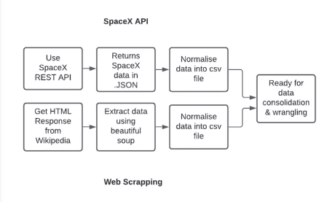
Data Collection
For this exercise, the data has been collected from two sources:
1. SpaceX API
2. Web Scraping

Slide 9
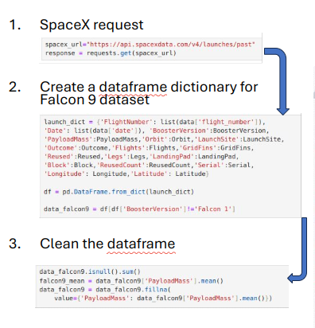
Data Collection- SpaceX API
SpaceX has provided a Rest API which contains all the data about launches, information about the rocket used, payload delivered, launch specifications, landing specifications, and landing outcome.
Github URL: https://github.com/capstone-spacex-data-collection-api.ipynb
Steps:
Make a GET request to SpaceX API
Store the data into a pandas dataframe object.
Further filter the data to get only Falcon 9 entries, remove null values and replace missing data.

Slide 10
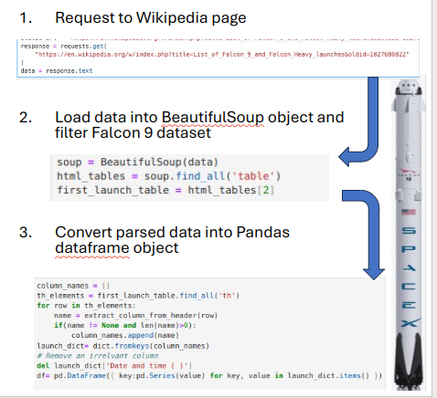
Data Collection- Web Scraping
For this, we used a Wikipedia page- "List of Falcon 9 and Falcon Heavy launches" to collect Falcon 9 historical launch records.
Source: https://en.wikipedia.org/wiki/List_of_Falcon_9_and_Falcon_Heavy_launches
Github URL: https://github.com/capstone-webscraping.ipynb
Steps:
Make a get request to Wikipedia URL
Store the html page into a BeautifulSoup object
Parse the BeautifulSoup html table with all the required columns.
Convert the parsed BeautifulSoup object into a Pandas Dataframe.

Slide 11
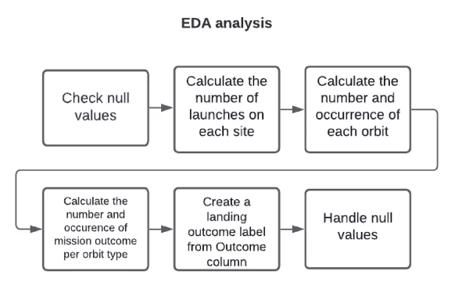
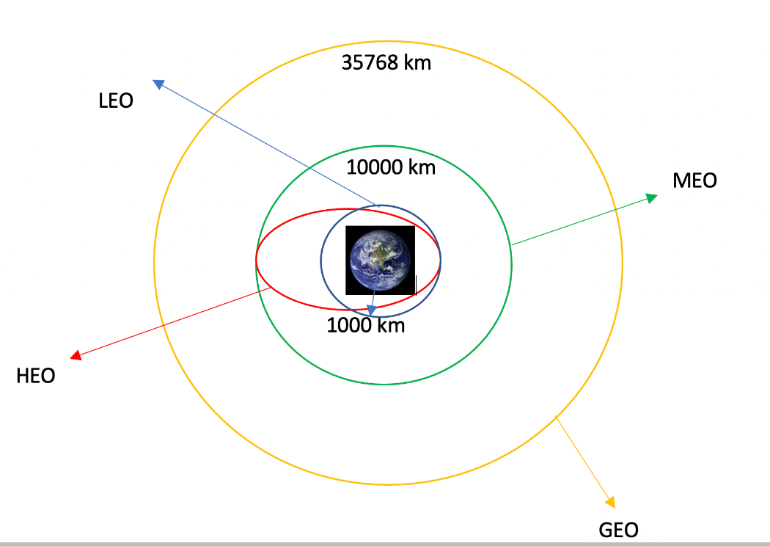
Data Wrangling
The SpaceX dataset contains several Space X launch facilities, and each location is in the "LaunchSite" column.
Each launch aims to a dedicated orbit, and some of the common orbit types are shown in the figure below. The orbit type is in the Orbit column.
Github URL: https://github.com/capstone-spacex-Data-wrangling.ipynb
Initial Data Exploration: Using the .value_counts() method to determine the following:
Number of launches on each site
Number and occurrence of each orbit
Number and occurrence of landing outcome per orbit type

Slide 12
Contd. Data Wrangling...
2. The landing outcome is shown in the Outcome column:
True Ocean – the mission outcome was successfully landed to a specific region of the ocean
False Ocean – the mission outcome was unsuccessfully landed to a specific region of the ocean.
True RTLS – the mission outcome was successfully landed to a ground pad
False RTLS – the mission outcome was unsuccessfully landed to a ground pad.
True ASDS – the mission outcome was successfully landed to a drone ship
False ASDS – the mission outcome was unsuccessfully landed to a drone ship.
None ASDS and None None – these represent a failure to land.
3. To determine whether a booster will successfully land, it is best to have a binary column, i.e., where the value is 1 or 0, representing the success of the landing.
This is done by:
Defining a set of unsuccessful (bad) outcomes, bad_outcome
Creating a list, landing_class, where the element is 0 if the corresponding row in Outcome is in the set bad_outcome, otherwise, it’s 1.
Create a Class column that contains the values from the list landing_class
Export the DataFrame as a .csv file.

Slide 13



Exploratory Data Analysis with Visualization
For the visual EDA, following charts are plotted.
SCATTER CHARTS
Scatter charts were produced to visualize the relationships between: Flight Number and Launch Site Payload and Launch Site Orbit Type and Flight Number Payload and Orbit Type
Scatter charts are useful to observe relationships, or correlations, between two numeric variables.
BAR CHART
A bar chart was produced to visualize the relationship between: Success Rate and Orbit Type
Bar charts are used to compare a numerical value to a categorical variable. Horizontal or vertical bar charts can be used, depending on the size of the data.
LINE CHARTS
Line charts were produced to visualize the relationships between: Success Rate and Year (i.e. the launch success yearly trend)
Line charts contain numerical values on both axes, and are generally used to show the change of a variable over time
Github URL: https://github.com/capstone-eda-dataviz.ipynb

Slide 14
Exploratory Data Analysis with SQL
EDA was done with SQL as well. Below are the queries performed using SQL:
Display the names of the unique launch sites in the space mission
Display 5 records where launch sites begin with the string ‘CCA’
Display the total payload mass carried by boosters launched by NASA (CRS)
Display the average payload mass carried by booster version F9 v1.1
List the date when the first successful landing outcome on a ground pad was achieved
List the names of the boosters which had success on a drone ship and a payload mass between 4000 and 6000 kg
List the total number of successful and failed mission outcomes
List the names of the booster versions which have carried the maximum payload mass
List the failed landing outcomes on drone ships, their booster versions, and launch site names for 2015
Rank the count of landing outcomes (such as Failure (drone ship) or Success (ground pad)) between the date 2010-06-04 and 2017-03-20, in descending order
Github URL: https://github.com/capstone-eda-sql.ipynb

Slide 15
Interactive Maps with Folium
The following steps were taken to visualize the launch data on an interactive map:
Mark all launch sites on a map
Initialise the map using a Folium Map object
Add a folium.Circle to add a highlighted circle area with a text label on a specific coordinate and folium.Marker for each launch site on the launch map
2. Mark the success/failed launches for each site on a map
As many launches have the same coordinates, it makes sense to cluster them together.
Before clustering them, assign a marker colour of successful (class = 1) as green, and failed (class = 0) as red.
To put the launches into clusters, for each launch, add a folium.Marker to the MarkerCluster() object.
Create an icon as a text label, assigning the icon_color as the marker_colour determined previously.

Slide 16
Contd. Interactive maps...
3. Calculate the distances between a launch site to its proximities
To explore the proximities of launch sites, calculations of distances between points can be made using the Lat and Long values.
After marking a point using the Lat and Long values, create a folium.Marker object to show the distance.
To display the distance line between two points, draw a folium.PolyLine and add this to the map.
Github URL: https://github.com/capstone-interactive-maps-folium.ipynb

Slide 17
Interactive Dashboard with Plotly Dash
The following plots were added to an interactive dashboard for visualisation of the
data:
Pie chart: It shows the total successful launches per site.
This makes it clear to see which sites are most successful.
The chart could also be filtered (using a dcc.Dropdown() object) to see the success/failure ratio for an individual site
2. Scatter graph: It shows the correlation between outcome (success or not) and payload mass (kg)
This could be filtered (using a RangeSlider() object) by ranges of payload masses
It could also be filtered by booster version
Github URL: https://github.com/spacex_dash_app.py

Slide 18
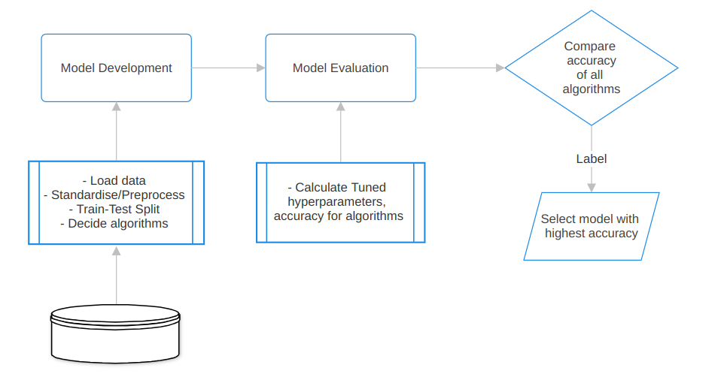
Predictive Analysis with Classification Models
Following steps were followed to find the best suited classification model:

Slide 19
Contd. Interactive maps...
Model Development:
Preprare dataset for model development
Load dataset
Standardise and preprocess data
Split data into training and testing sets using train_test_split()
Choose an algorithm to build model for: Logistic Regression, Decision tree, Support Vector Machine (SVM), K-Neatest Neighbour(KNN)
For each chosen algorithm:
Create a GridSearchCV object with dictionary parameters.
Fit the object to get the best parameters from dictionary parameters.
Use training data set to train the model

Slide 20
Contd. Interactive maps...
2. Model Evaluation:
For each chosen algorithm:
Check tuned hyperparameters (best_params_) for output GridSearchCV
Check accuracy of output GridSearchCV (using best_score_ and .score())
Plot and examine confusion matrix
3. Conclusion: Find the best classification model
Review the accuracy score drawn from all the algorithms.
The model with highest accuracy score will be considered as best suited classification model.
Github URL: https://github.com/capstone-prediction-analysis.ipynb

Slide 21
Results
Exploratory Data Analysis
Interactive Analytics
Predictive Analysis

Slide 22
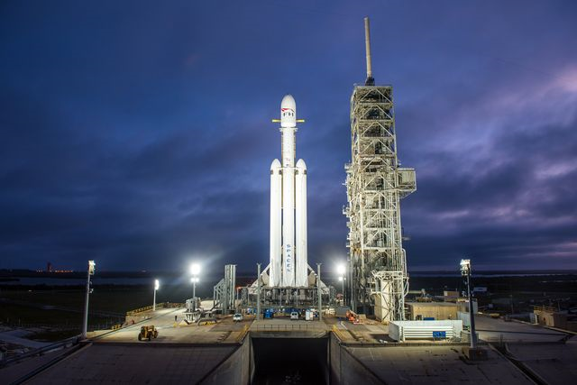
Exploratory Data Analysis (EDA) Insights

Slide 23
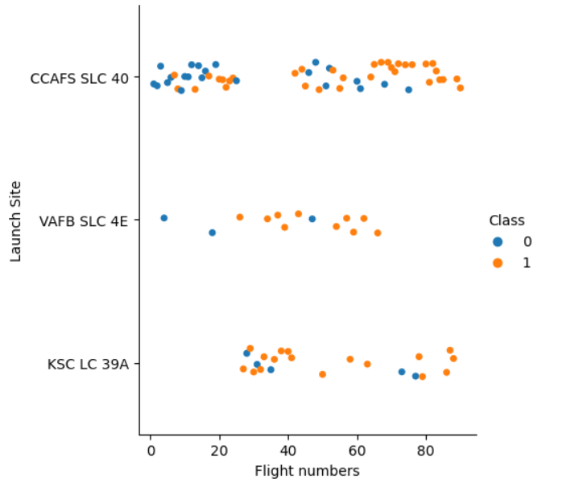
Flight Number vs. Launch Site
Following is the scatter plot of Launch Site vs. Flight Number.
As the number of flights increased, launch site success rate also increased.
Lot of CCAFS SLC 40 flights had unsuccessful landings for initial flights < 30
No flights were launched initially for KSC LC 39A
After 30 flights, there are significantly more successful landings for Class 1

Slide 24
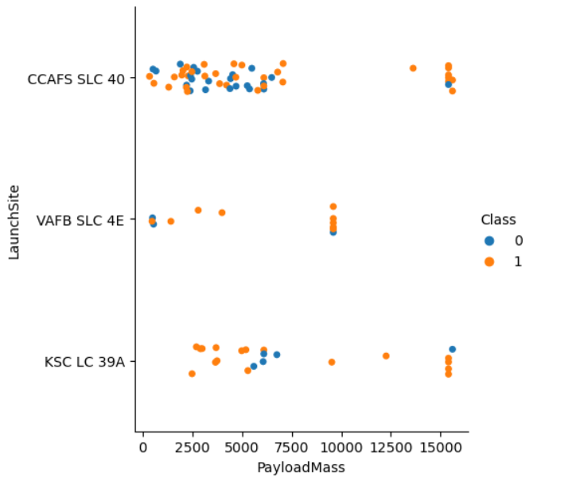
Payload vs. Launch Site
Following is the scatter plot of Launch Site vs. Payload
Above a payload mass of around 7000 kg, there are very few unsuccessful landings, but there is also far less data for these heavier launches.
There is no clear correlation between payload mass and success rate for a given launch site.
All sites launched a variety of payload masses, with most of the launches from CCAFS SLC 40 being comparatively lighter payloads (with some outliers).

Slide 25
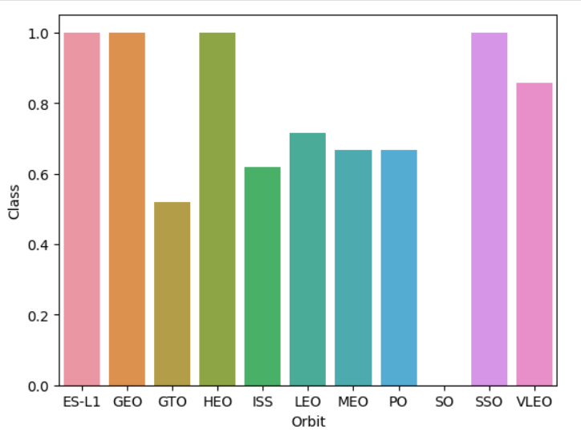
Success Rate vs. Orbit Type
The bar chart of Success Rate vs. Orbit
Type shows that the following orbits
have the highest (100%) success rate:
ES-L1 (Earth-Sun First Lagrangian Point)
GEO (Geostationary Orbit)
HEO (High Earth Orbit)
SSO (Sun-synchronous Orbit)
The orbit with the lowest (0%) success
rate is:
SO (Heliocentric Orbit)

Slide 26
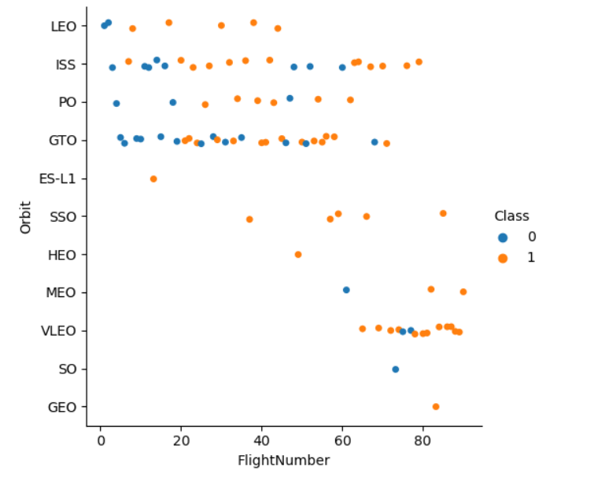
Flight Number vs. Orbit Type
This scatter plot of Orbit Type vs. Flight
number shows a few useful things that
the previous plots did not, such as:
The 100% success rate of GEO, HEO and ES-L1 orbits can be explained by only having 1 flight into the respective orbits.
The 100% success rate in SSO is more impressive, with 5 successful flights.
There is little relationship between Flight Number and Success Rate for GTO.
Generally, as Flight Number increases, the success rate increases. This is most extreme for LEO, where unsuccessful landings only occurred for the low flight numbers (early launches).

Slide 27
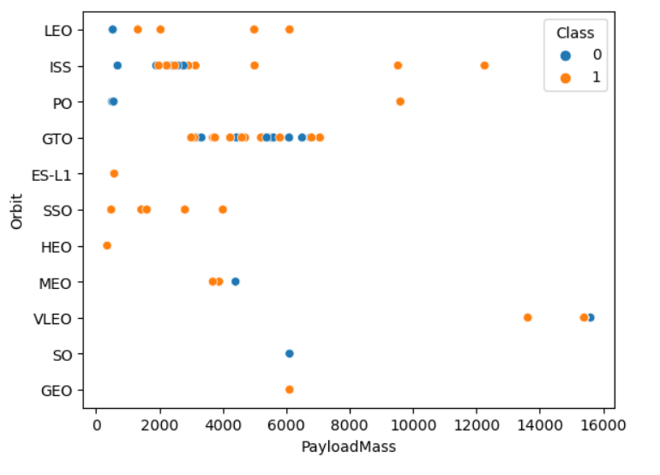
Payload vs. Orbit Type
This scatter plot of Orbit Type vs. Payload
Mass shows that:
Orbit types PO, ISS, LEO have more success with heavy payloads. Although the number of data points for PO is small.
For GTO, the relationship between payload mass and success rate is unclear.
VLEO (Very Low Earth Orbit) launches are associated with heavier payloads, which makes intuitive sense.

Slide 28
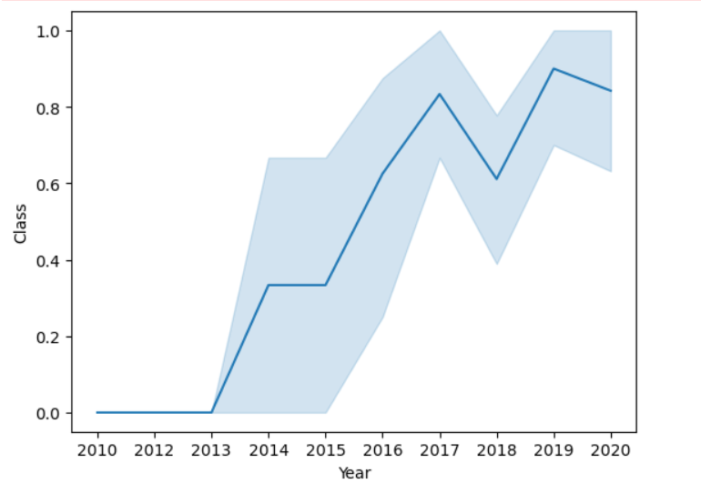
Launch Success Yearly Trend
The line chart of yearly average success
rate shows that:
Between 2010 and 2013, all landings were unsuccessful (as the success rate is 0).
After 2013, the success rate generally increased, despite small dips in 2018 and 2020.
After 2016, there was always a greater than 50% chance of success.

Slide 29
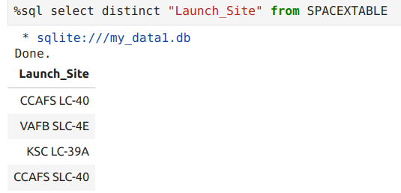
All Launch Sites
There are total 4 unique Launch Sites as follows:
CCAFS SLC 40
VAFB SLC 4E
KSC LC 39A
CCAFS LC-40

Slide 30
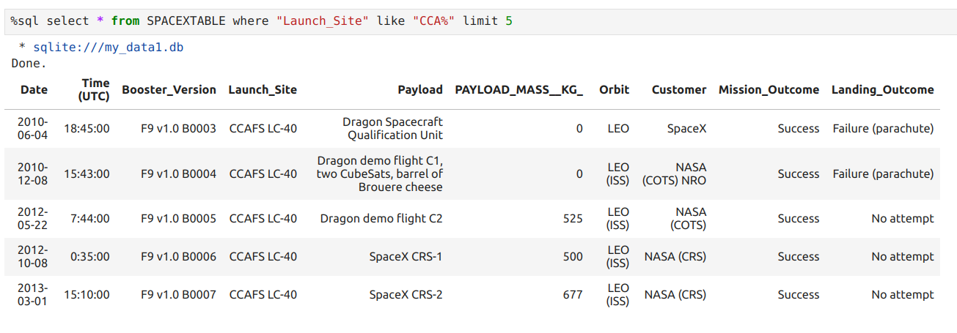
Launch Site Names begin with 'CCA'
Finding launch sites whose name begins with 'CCA'
The 'Limit 5' keyword showcases only first 5 records
The 'LIKE' keyword is used with wildcard symbol '%' to retrieve string values which starts with 'CCA'

Slide 31
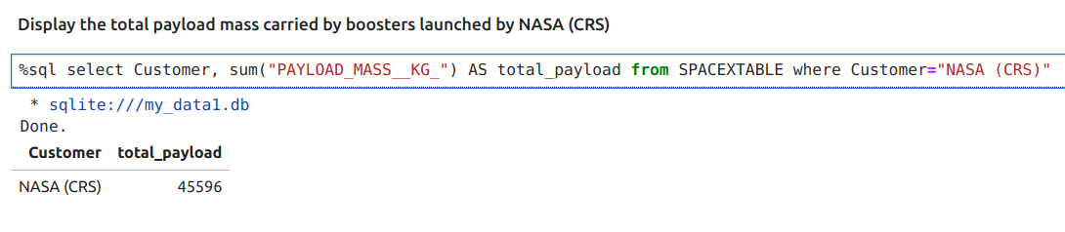
Total Payload Mass
Calculate the total payload carried by boosters from NASA
The 'SUM' is an aggregate function used to calculate summation of specified column on the data filtered with 'WHERE' condition.

Slide 32
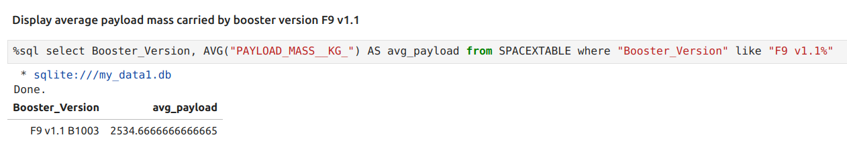
Average Payload Mass carried by booster F9 V1.1
Calculate the average payload carried by boosters version F9 v1.1
The 'AVG' is an aggregate function used to calculate average/mean of 'PAYLOAD_MASS__KG_' column on the data filtered with 'WHERE' condition to fetch 'Booster_Version' F9 v1.1 .

Slide 33
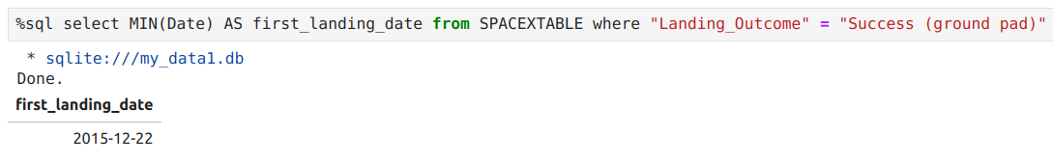
First Successful Ground Landing
Find the first successful ground landing date
The 'MIN' is an aggregate function used to fetch the smallest value of 'DATE' column on the data filtered with 'WHERE' condition for successful ground pad landing.

Slide 34
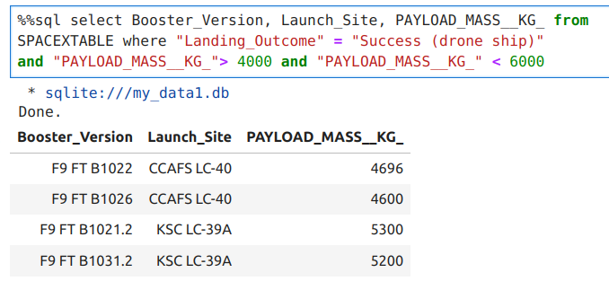
Successful Drone Ship Landing with Payload between 4000 and 6000
Listing names of boosters which have successfully landed on drone ship and had payload mass greater than 4000 but less than 6000.
Here, 'AND' clause is used to specify the range for 'PAYLOAD_MASS__KG_' to be between 4000 to 6000

Slide 35
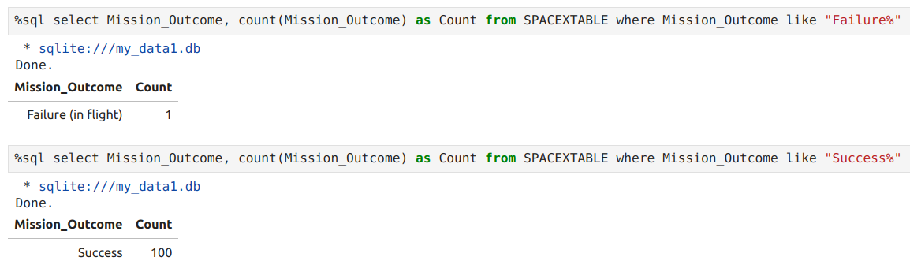
Total Successful and Failed Mission Outcome
Get total number of failure and successful mission outcome.
The COUNT keyword is used to calculate the total number of mission outcomes, and the GROUPBY keyword is also used to group these results by the type of mission outcome.

Slide 36
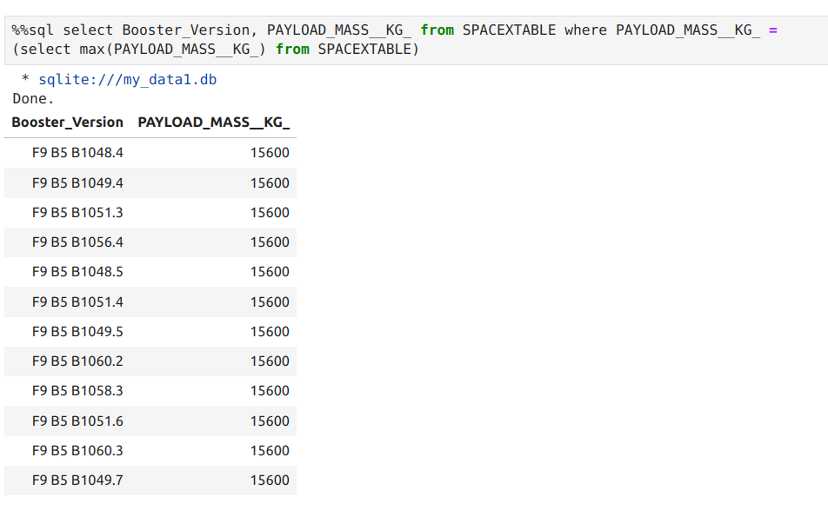
Boosters carrying maximum Payload
List the names of the booster which have carried the maximum payload mass.
A subquery is used here. The SELECT statement within the brackets finds the maximum payload, and this value is used in the WHERE condition. The DISTINCT keyword is then used to retrieve only distinct /unique booster versions.

Slide 37
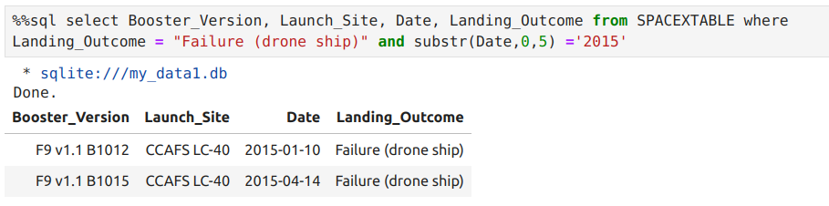
2015 Launch Records
Listing the failed landing outcomes in drone ship, their booster versions, and launch site names for in year 2015
The SUBSTR function is used to extract only year from the 'DATE'

Slide 38
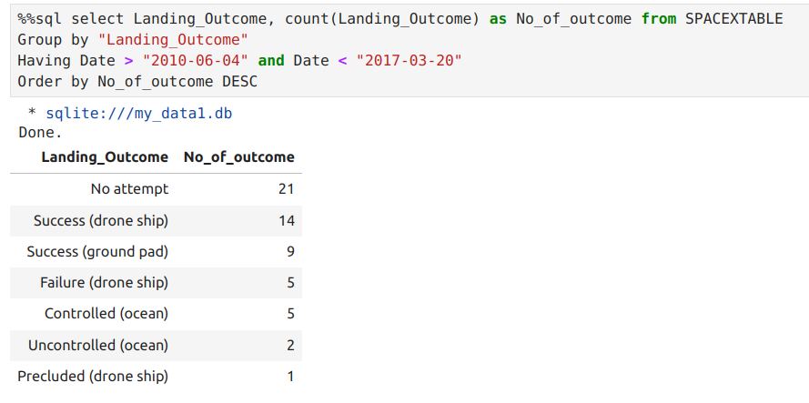
Ranking Landing Outcomes Between 2010-06-04 and 2017-03-20
Rank the count of landing outcomes (such as Failure (drone ship) or Success (ground pad)) between the date 2010-06-04 and 2017-03-20, in descending order.
The WHERE keyword is used with the AND keyword to filter the results to dates only within those specified. The results are then grouped and ordered, using the keywords GROUP BY and ORDER BY, respectively, where DESC is used to specify the descending order.

Slide 39

Launch Sites Proximities Analysis

Slide 40
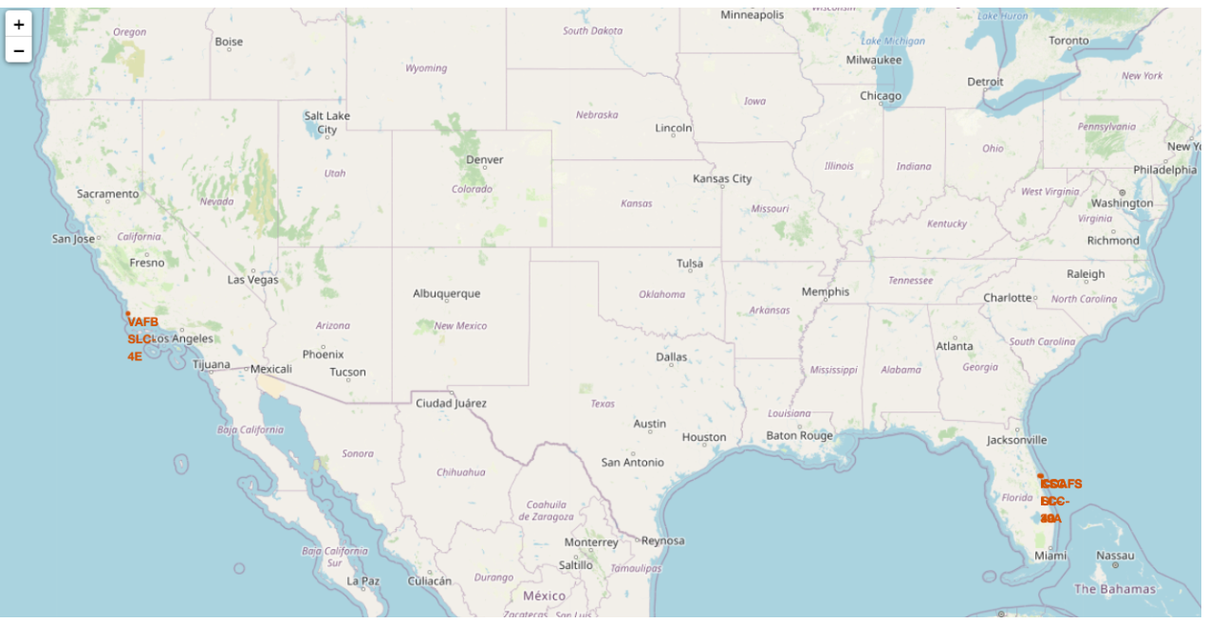
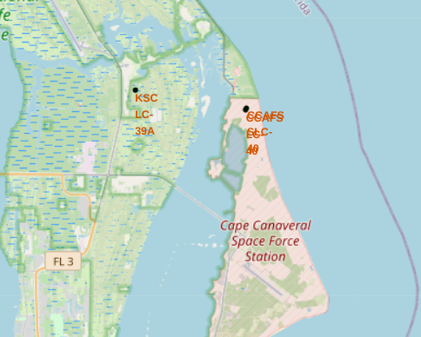
Mark All Launch Sites on Map
All SpaceX launch sites are on coasts of the United States of America, specifically Florida and California.

Slide 41
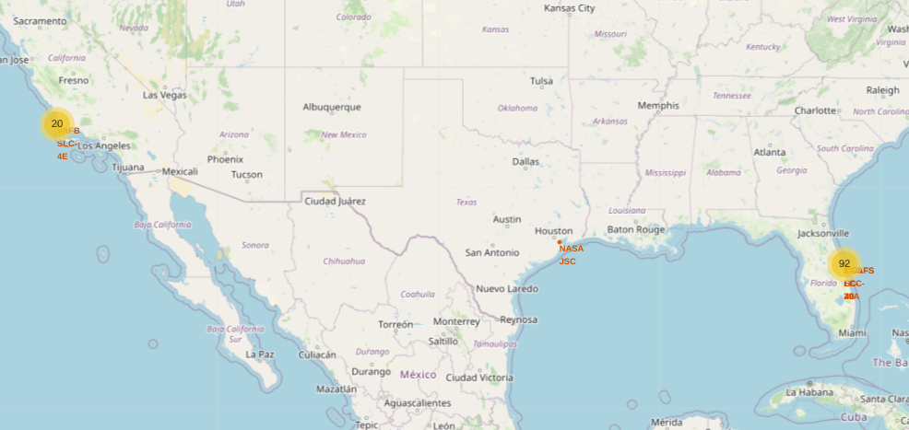
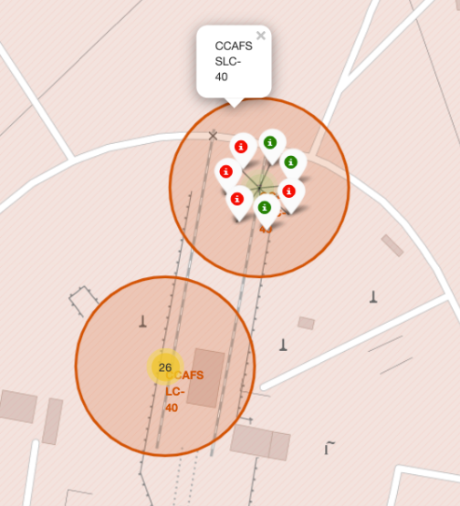
Mark Success and Failed Launch Sites on Map
Launches have been grouped into clusters, and annotated with green icons for successful launches, and red icons for failed launches.

Slide 42
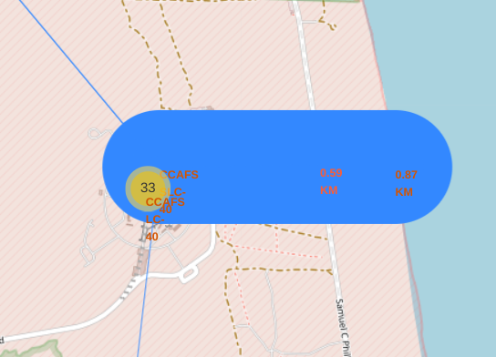
Distances between a Launch Site to Proximities
Using the CCAFS SLC-40 launch site as an example site, we can understand more about the placement of launch sites.
Are launch sites in close proximity to railways?
YES. The coastline is only 0.87 km due East.
2. Are launch sites in close proximity to highways?
YES. The nearest highway is only 0.59km away.
3. Are launch sites in close proximity to railways?
YES. The nearest railway is only 1.29 km away.
4. Do launch sites keep certain distance away from cities?
YES. The nearest city is 51.74 km away.

Slide 43

Interactive Dashboard with Plotly Dash

Slide 44
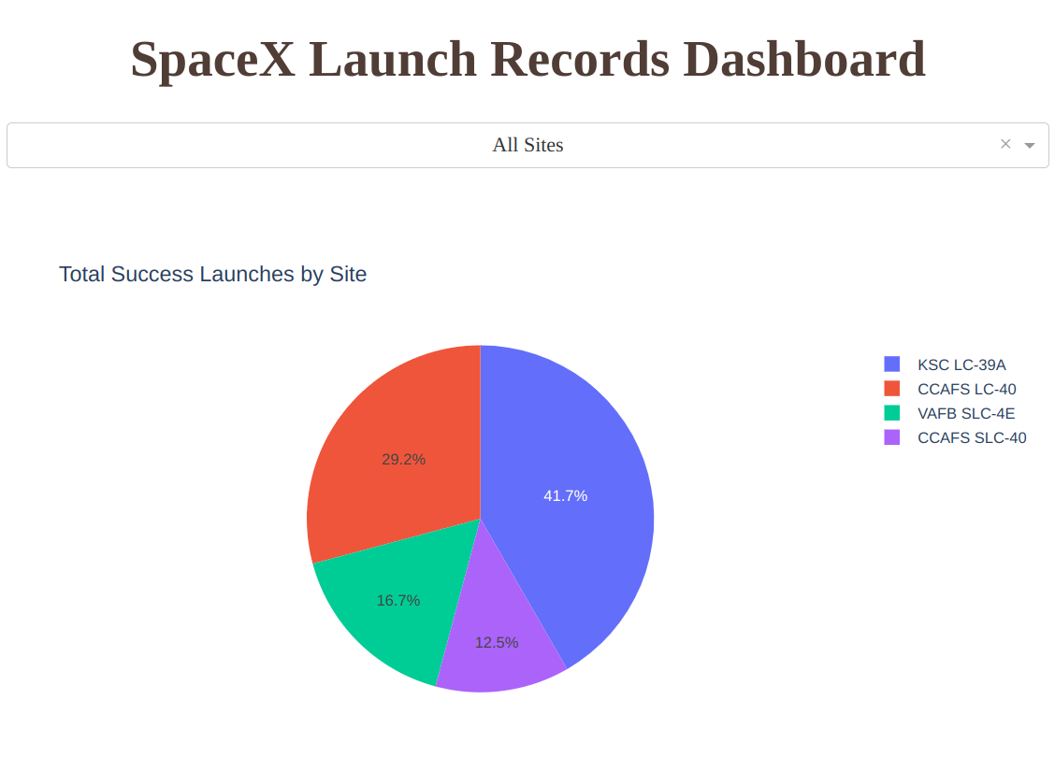
Launch Success for All Sites
KSC LC 39A had most successful launches among all the sites with 41.7% and CCAFS SLC-40 with least successful launches of 12.5%

Slide 45
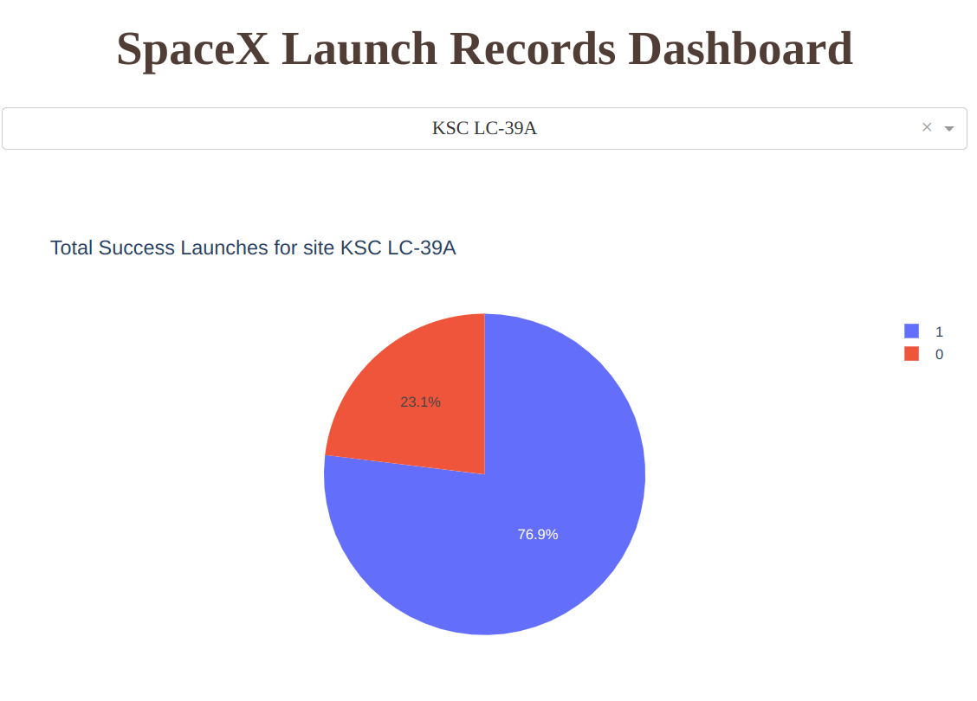
Launch Success for KSC LC 39A
KSC LC 39A had successful launches with a success rate of 76.9%
It also high among all other site's success rate.

Slide 46
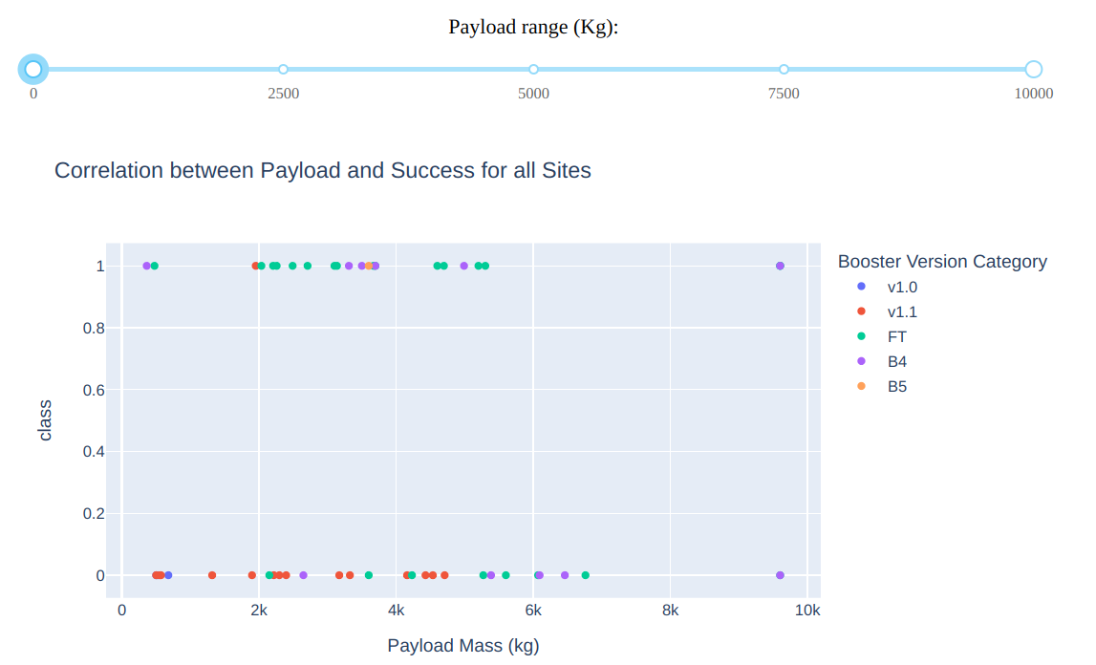
Launch Outcome VS. Payload scatter plot for all sites
Plotting the launch outcome vs. payload for all sites shows a gap around 4000 kg, so it makes sense to split the data into 2 ranges:
0 – 4000 kg (low payloads)
4000 – 10000 kg (massive payloads)
Low Payload
Massive Payload

Slide 47
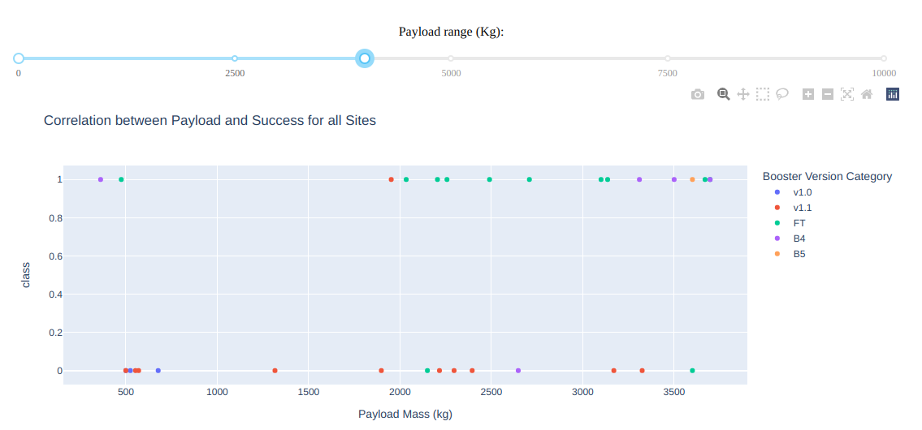
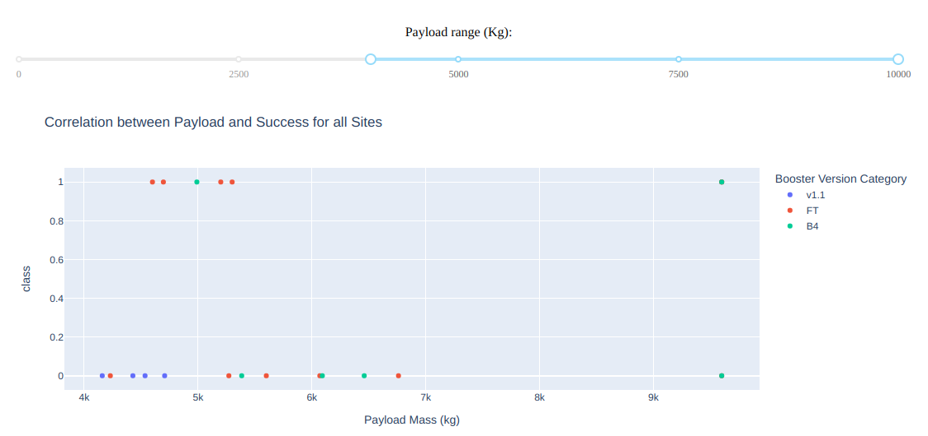
Contd. Launch Outcome VS. Payload scatter plot for all sites
Low Payload
Massive Payload
From these 2 plots, it can be shown that the success for massive payloads is lower than that for low payloads.
It is also worth noting that some booster types (v1.0 and B5) have not been launched with massive payloads.

Slide 48
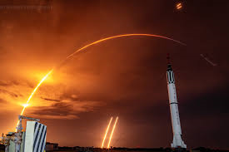
Predictive Analysis (Classification)

Slide 49
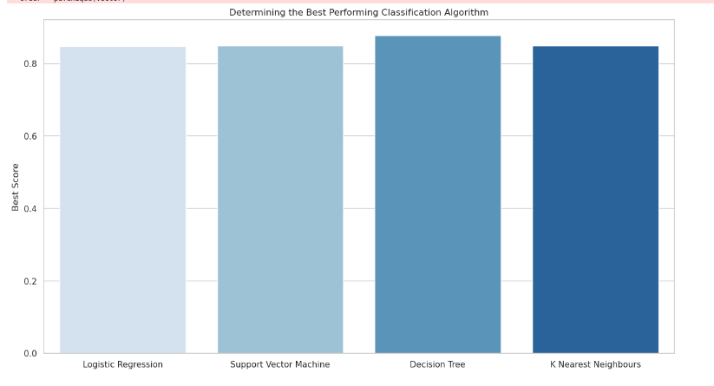
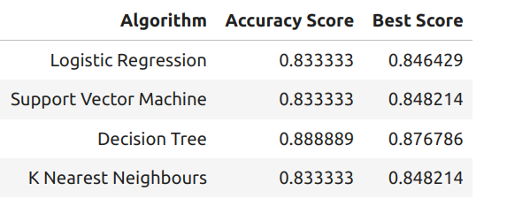
Classification Accuracy
Plotting the Accuracy Score and Best Score for each classification algorithm produces the following result:
The Decision Tree model has the highest classification accuracy
The Accuracy Score is 94.44%
The Best Score is 90.36%

Slide 50
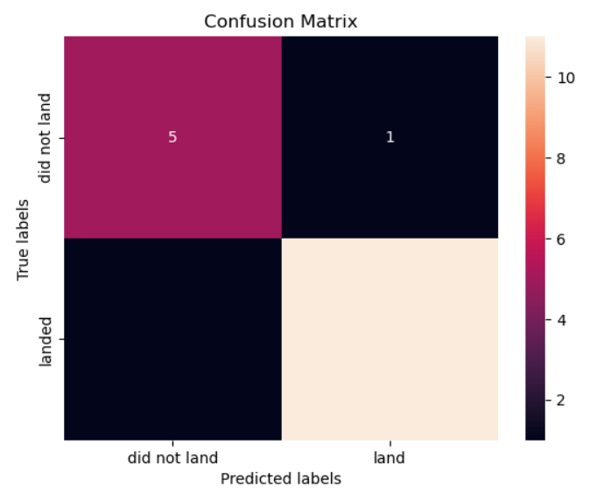
Confusion Matrix
As shown previously, best performing classification model is the Decision Tree model, with an accuracy of 94.44%.
This is explained by the confusion matrix, which shows only 1 out of 18 total results classified incorrectly (a false positive, shown in the top-right corner).
The other 17 results are correctly classified (5 did not land, 12 did land).

Slide 51
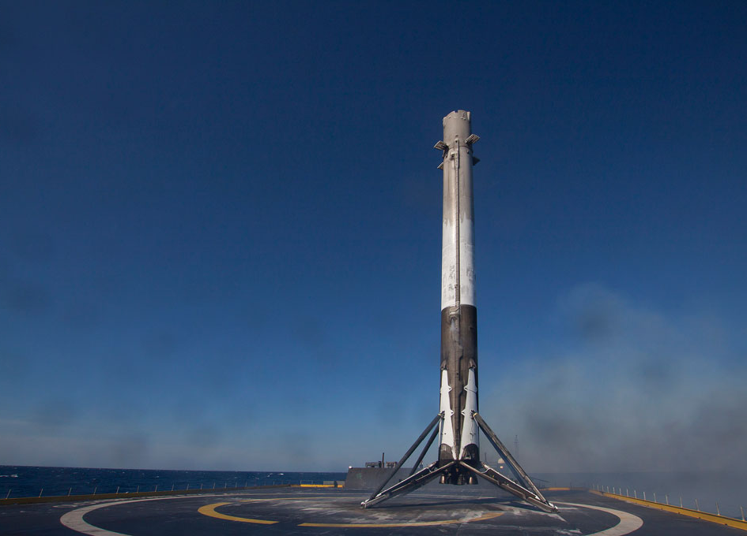
Conclusion

Slide 52
Conclusion
As the number of flights increases, the rate of success at a launch site increases, with most early flights being unsuccessful. I.e. with more experience, the success rate increases.
Between 2010 and 2013, all landings were unsuccessful (success rate is 0).
After 2013, the success rate generally increased, despite small dips in 2018 and 2020.
After 2016, the chance of success has been more than 50%.
Orbit types ES-L1, GEO, HEO, and SSO have the highest (100%) success rate.
The 100% success rate of GEO, HEO, and ES-L1 orbits can be explained by only having 1 flight into the respective orbits.
The 100% success rate in SSO is more impressive, with 5 successful flights.
The orbit types PO, ISS, and LEO, have more success with heavy payloads: VLEO (Very Low Earth Orbit) launches are associated with heavier payloads, which makes intuitive sense.
The launch site KSC LC-39 A had the most successful launches, with 41.7% of the total successful launches, and also the highest rate of successful launches, with a 76.9% success rate.
The success for massive payloads (over 4000kg) is lower than that for low payloads.
The best performing classification model is the Decision Tree model, with an accuracy of 94.44%.

Slide 53
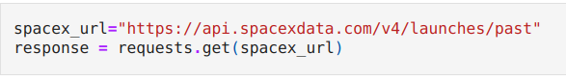
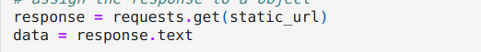
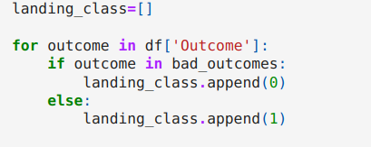
Appendix
Data Collection:
Custom functions to retrieve required information
Custom logic to clan the data
1. SpaceX Rest API:
2. Web Scrapping: Read Wikipedia page from its URL
Data Wrangling:
Exploratory Data Analysis
Determine Training Labels
If Outcome is in state {'False ASDS', 'False Ocean',
'False RTLS', 'None ASDS', 'None None'}
then landing_class = 0
Else landing_class = 1

Slide 54
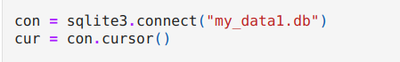
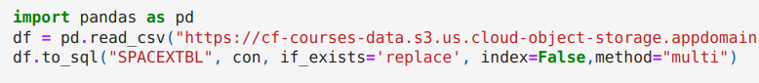
Cont. Appendix
Data Visualization:
Plotting different types of plots to identify relationship between each entity.
Types of plots used: Scatter plot, Bar chart and Line chart
Libraries used: Seaborn and Matplotlib
Features Engineering: Identifying features that can be used in success prediction.
Creating dummy categorical columns
SQL:
Connecting to database
Read data into a table

Slide 55

Thank You!

